Slide 1

Bangladesh University of Business and Technology
A Presentation on
Diabetes Prediction System
Using Machine Learning

Slide 2






Team : Diagon-Alley
Team Members
Md. Rashadul Islam
Md. Faysal Mahmud
Sadia sultana
Dipa Rani
Id: 19202103169
Id: 19202103174
Id: 19202103184
Id: 19202103201

Slide 3
Introduction
Diabetes prediction system is a ML Model that uses patient data to predict Diabetes
This system uses various input variables, including age, BMI, blood pressure
etc. to make predictions
The system can help doctors and patients identify potential diabetes risks early
With accurate predictions, the system can ultimately improve patient outcomes
and reduce healthcare costs associated with diabetes management.

Slide 4

Literature Review
Various algorithms have been used – as like LR, KN, SVC, RF, DT, GBC
Data sources for training models
Feature section and data preprocessing are essential for
model accuracy and interpretability
Performance metrics used to evaluate models

Slide 5
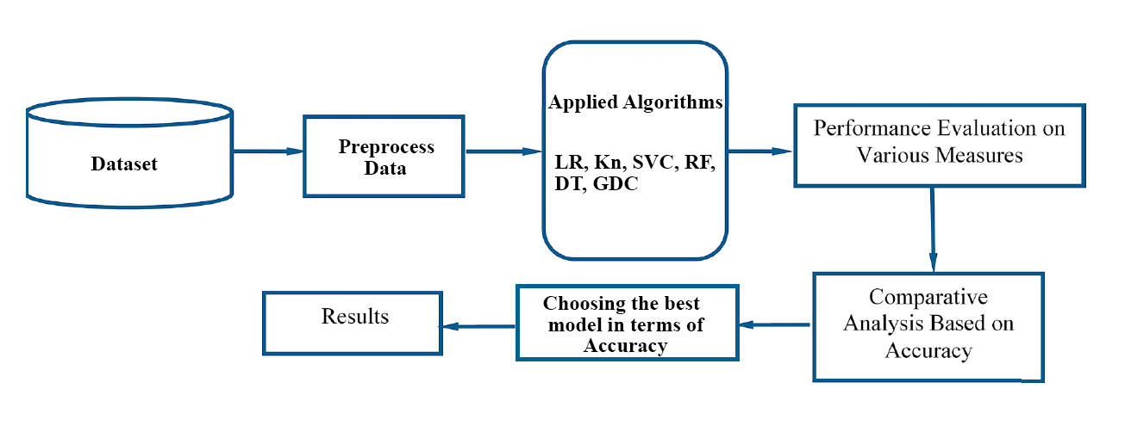
Proposed Model
Algorithms
Logistic Regression
K-Neighbors Classifier
Support Vector Classifier
Random Forest Classifier
Decision Tree Classifier
Gradient Boosting Classifier

Slide 6

Implementation & Result Analysis
Dataset Details – as like rows, columns, Memory size etc.
Implemented graph –
Diabetes , Non-Diabetes Graph
Mean Value Graph
Separating Data & Label’s Graph
Creating Heat-Map , Validation Set
Store Feature Matrix and Splitting Data for Training and Testing
F1 Score, Confusion Matrix, Training & Testing Loss
Accuracy Score with Graph

Slide 7
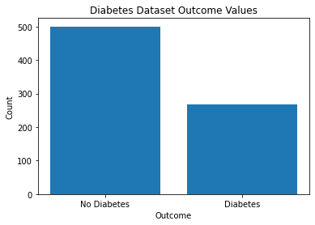
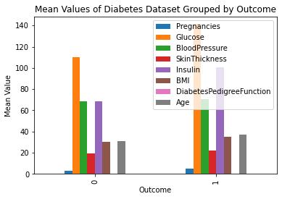
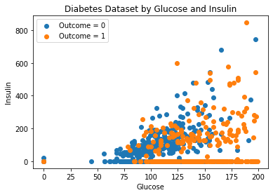
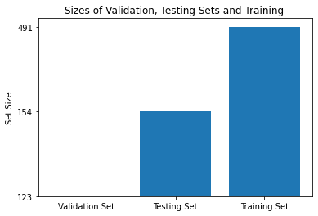
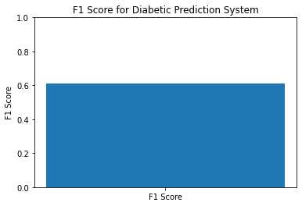
Fig. 1 – Diabetes & Non-Diabetes Graph
Fig. 2 – Mean Value Graph
Fig. 3 – Separating Diabetes Dataset
by Glucose and Insulin
Fig. 4 – Validation, Testing & Training Set
Fig. 5 – F1 Score

Slide 8
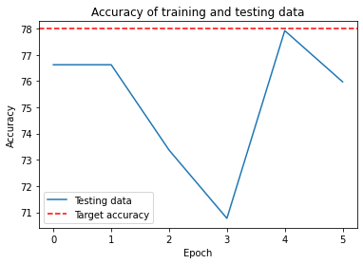
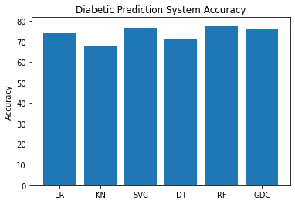
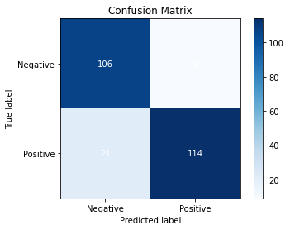
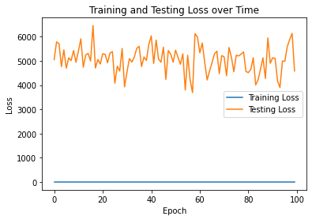
Fig 6 – Training & Testing Loss
Fig 7 – Accuracy of Training & Testing Data
Fig 8 – Accuracy of all Algorithm
Fig 9 – Confusion Matrix

Slide 9

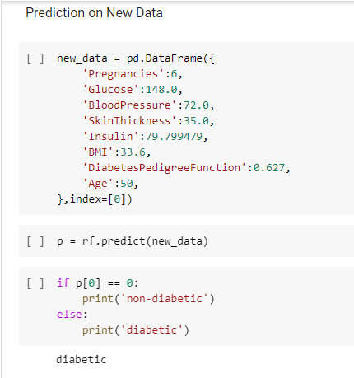

Fig 10 – An Example of How the system Predict from a New Data

Slide 10
Conclusion & Future Work
The diabetes prediction system using machine learning is a promising approach
for early detection and treatment of diabetes.
It accurately predicts the likelihood of developing diabetes based on medical history
and lifestyle factors
Further development and testing can help refine the system and improve its accuracy
and effectiveness.

Slide 11
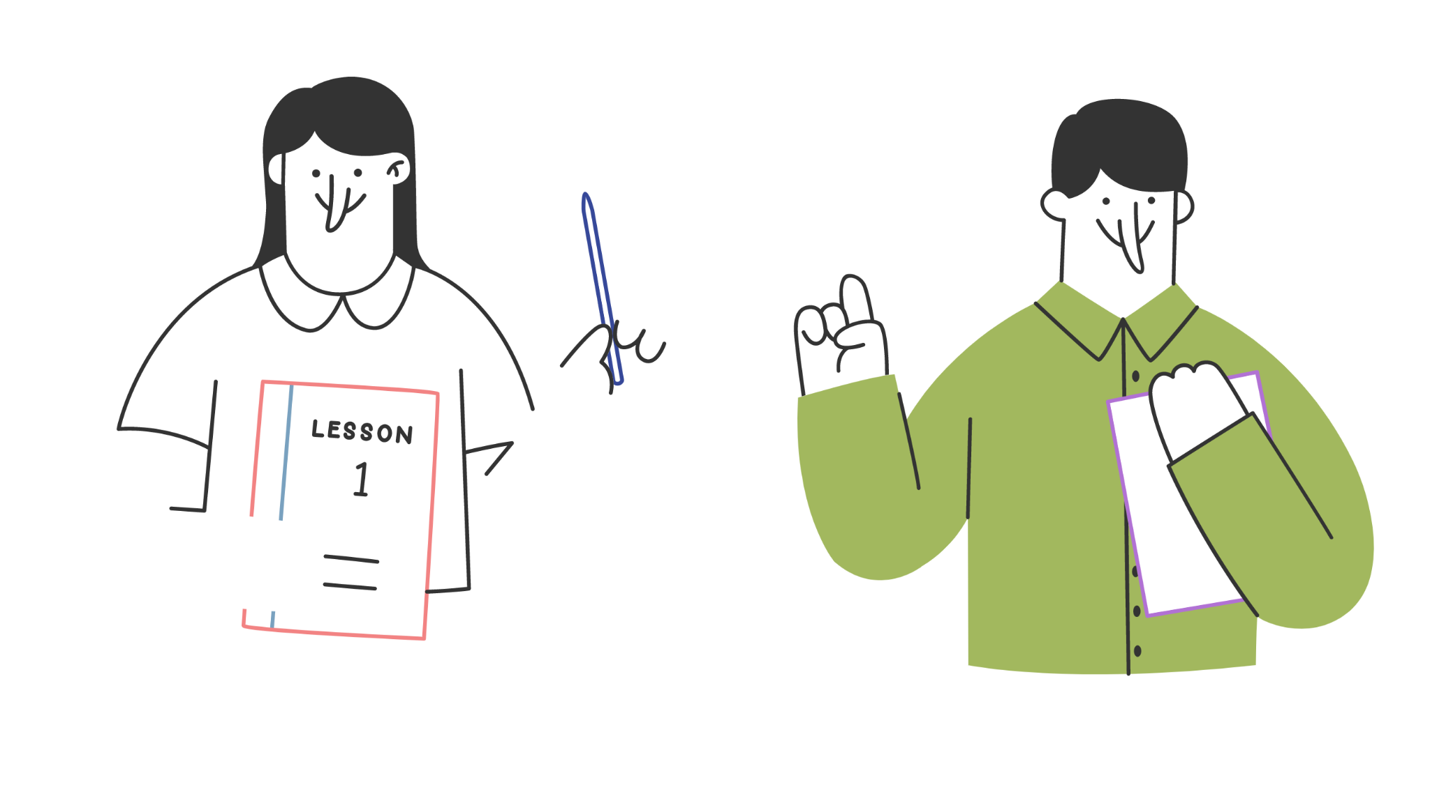
Thank you!

